Slide 1

J2M Converter
Pooja Baba #002677117 MS in Computer Science (May 2023)
Dr. Raj Sunderraman (advisor) Professor and Associate Chair Department of Computer Science Georgia State University
Notes:
Hello Dr.Raj and Dr.Shiraj. A very good evening to you both. I Pooja Baba, am a Masters student in Computer Science majors graduating in Spring 2023. Today I will be presenting my Masters project J2M: A JSONiq to MongoDB converter, completed under the guidance of Dr. Raj Sunderraman.

Slide 2



Agenda
Motivation
Problem Statement
Implementation Model
Demo
Conclusion
Future Work
References
Notes:
So as we proceed, we will be going through the following agenda. Starting with what was the motivation to this project, how that led us to formulate the problem statement. Discussing about the implementation model, quick demo of the project built, conclusion, future work and the references.

Slide 3
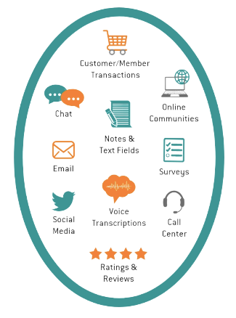
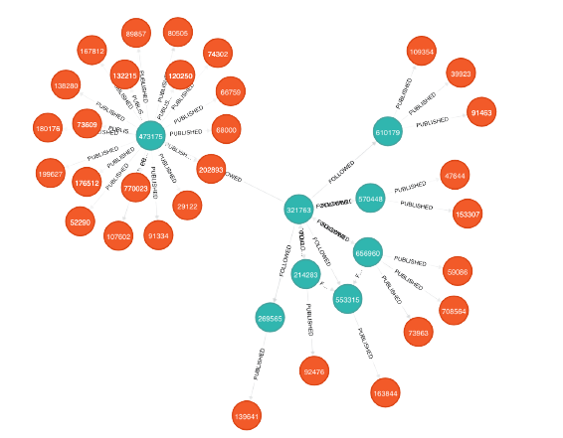
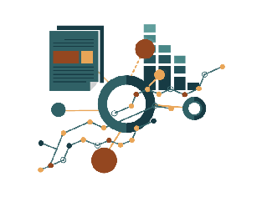
Motivation
Unstructured data is the new data - JSON
Efficient and easy data access
Numerous types of databases and query languages
Notes:
In today's world where data plays a key role, we know that it has become difficult to implement the structured databases for every use cases. Hence the concept of NoSQL has been built to deal with data that can be unstructured. And with unstructured data, JSON has become the most popular element of modern database. This is because of the ease and the efficiency of the data access. Having JSON as the foundation various databases and query languages have been created.

Slide 4

Problem Statement
Different tools, databases, different query languages, syntax
Design a system that uses JSONiq to query from MongoDB
Notes:
These various tools, databases and query languages have their own sytax that one needs to keep in mind or learn. For an individual it becomes a bit difficult and confusing to master all at once. Hence, an idea popped to design and develop a system that can convert a query language for JSON from one form to another and query an actual database and fetch results for the user. Leading to designing a system that uses JSONiq to query from a MongoDB. Here we know that JSONiq itself is a different query language that uses a different syntax all together and can be only queryed on JSON file/ JSON content. But since MongoDB has all JSON base, we decided to build a system that can bring data from the MongoDB using JSONiq query language.

Slide 5
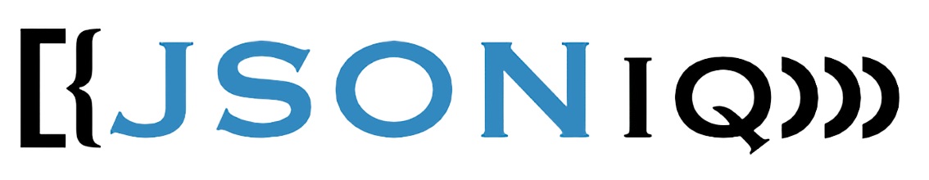

Some basics
Query language designed for popular JSON data model
JDM – JSONiq Data Model compatible with multiple JSON-like formats
JSONiq values – sequence of items, item can be atomic value, an object, an array, or a function item called dynamically
Classified as document-oriented NoSQL database program
Uses JSON-like documents with optional schemas
Uses MQL – MongoDB Query Language
Notes:
Since I have been talking about JSONiq and MongoDB for quite some time, I would like to talk now about the basics of both. Starting with JSONiq - it is a query language specifically designed for the popular JSON data model. The main ideas of JSONiq are based on the lessons learnt from the relational query systems and semi-structured data experience. This query language can do all the operations similar to SQL like - select/project, filter, join, group, order. This is commonly known as FLOWR for JSONiq. There is JDM i.e., JSONiq Data Model involved with multiple JSON-like formats that include - text, csv, parquet. And any JSONiq value is a sequence of items where an item can be an atomic value, an object, an array or a function called dynamically. Coming to MongoDB, it is classified as a document-oriented NoSQL database program. Though MongoDB has data storage in BSON format, the underlying concept is JSON. It uses JSON-like documents with optional schema. The query language used is MQL - MongoDB query language.

Slide 6
Implementation Model
Input query (JSONiq)
Tokenize Input query
Generate AST (parser)
Check for semantic errors
Generate expression tree
Print data
Modify results
Execute query
(pymongo, MongoClient)
Create MongoDB query

Slide 7

Demo

Slide 8

Conclusion
J2M Converter bridges the gap between JSONiq query language and MongoDB
No extra cost of learning MongoDB query language
Notes:
Hence with the system designed and built so far, we are able to bridge the gap between JSONiq query language and MongoDB. With this there is no extra cost/overhead of learning MongoDB query language to query MongoDB.

Slide 9

Future Work
FLWOR – For, Let, Where, Order, and Return clauses
Extend the Where clause by adding quantifiers – some and every
Implementing the same for Let and Order clauses
User Interface for interaction
Code customization to work with other JSON database systems – e.g., CouchDB and other NoSQL systems

Slide 10
References
Big Data for Engineers, Querying Trees, by Ghislain Fourny
PLY (Python Lex - Yacc) documentation
Python MongoDB (pymongo)
JSONiq documentation, JSONiq Book, by Ghislain Fourny

Slide 11


Thank You
Pooja Baba pbaba1@student.gsu.edu Website
Dr. Raj Sunderraman rajsunderraman@gsu.edu Website

